Slide 1


HEP NTUA Top Angular Report 13/12/2020
George Bakas

Slide 2
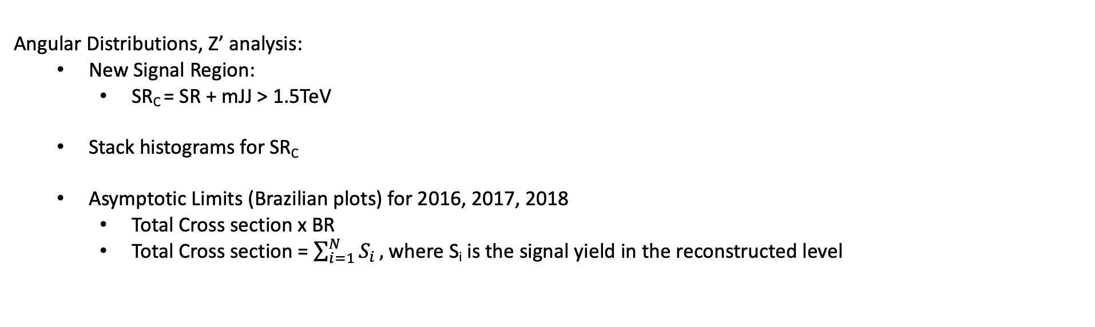
Summary
Angular Distributions, Z’ analysis:
New Signal Region:
SR_{C} = SR + mJJ > 1.5TeV
Stack histograms for SR_{C}
Asymptotic Limits (Brazilian plots) for 2016, 2017, 2018
Total Cross section x BR
Total Cross section = $\sum_{i=1}^{N}{S_{i}},$where S_{i} is the signal yield in the reconstructed level

Slide 3
Stack Distributions vs B2G-16-015 Mz=2TeV, w 1%
2016
2018
2017

Slide 4
Stack Distributions vs B2G-16-015 Mz=2TeV, w 10%
2016
2018
2017

Slide 5
Stack Distributions Mz = 2.5TeV, w 1%
2016
2018
2017

Slide 6
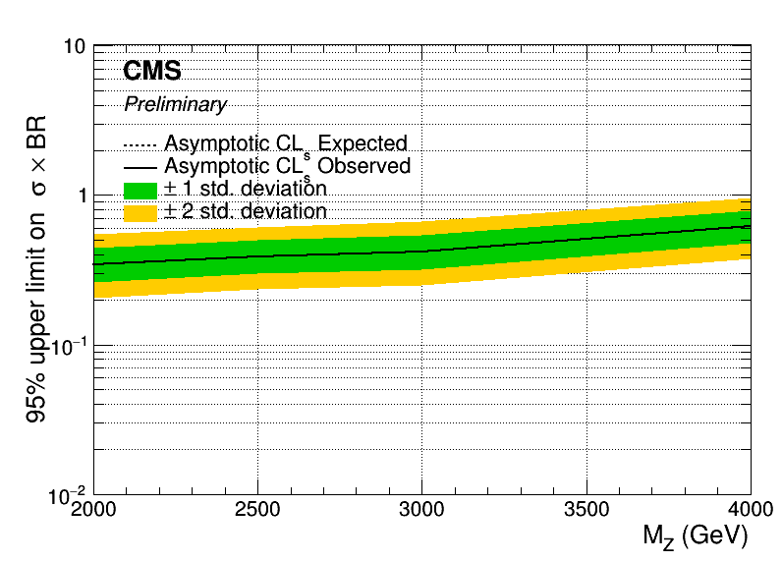
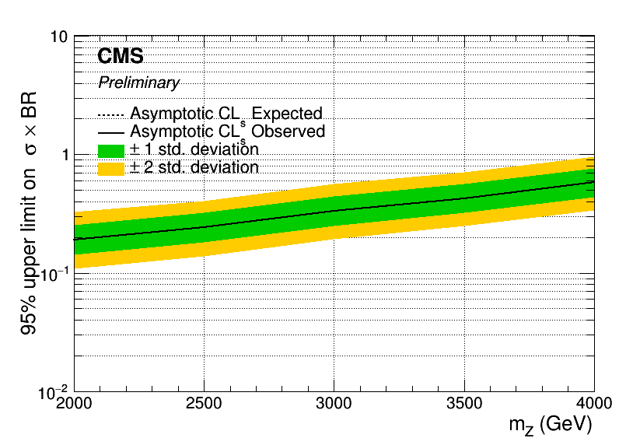
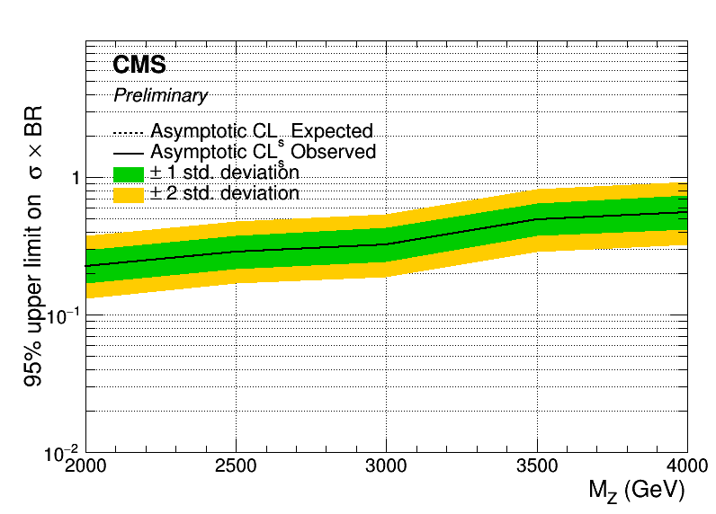
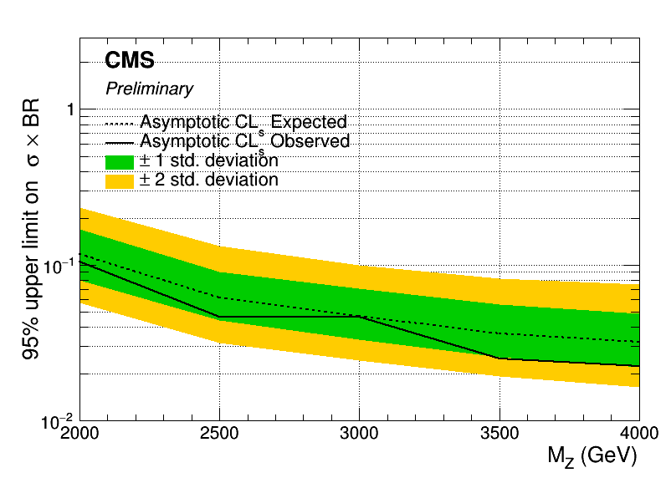
Asymptotic Limits width 1%
2016
2017
2018
B2G-16-015

Slide 7
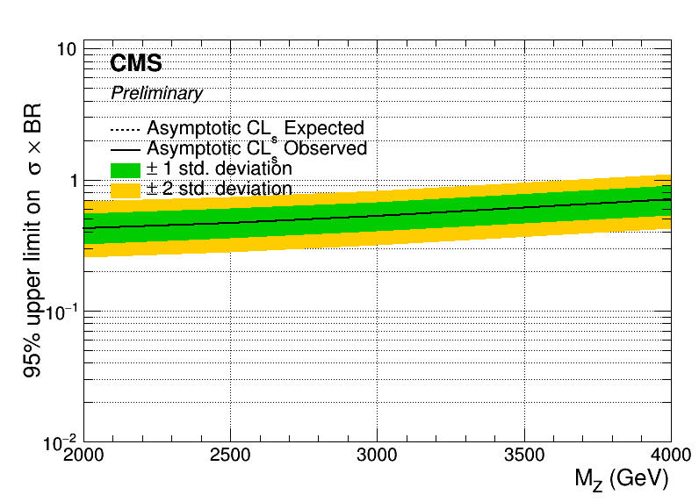


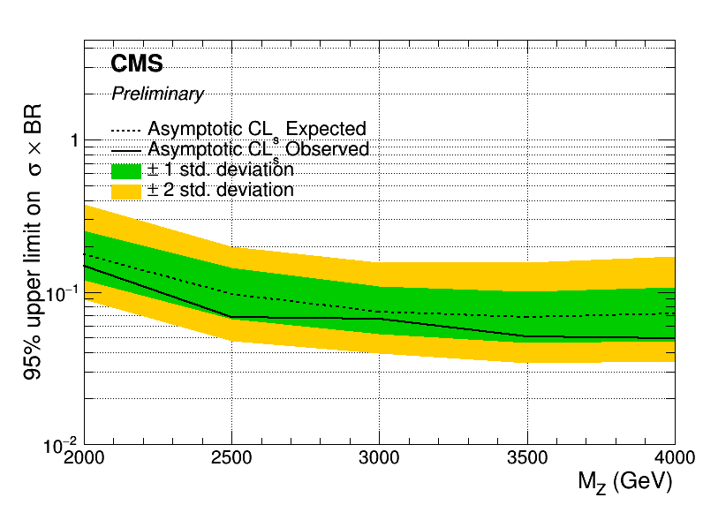
Asymptotic Limits width 10%
2016
2017
2018
B2G-16-015

Slide 8
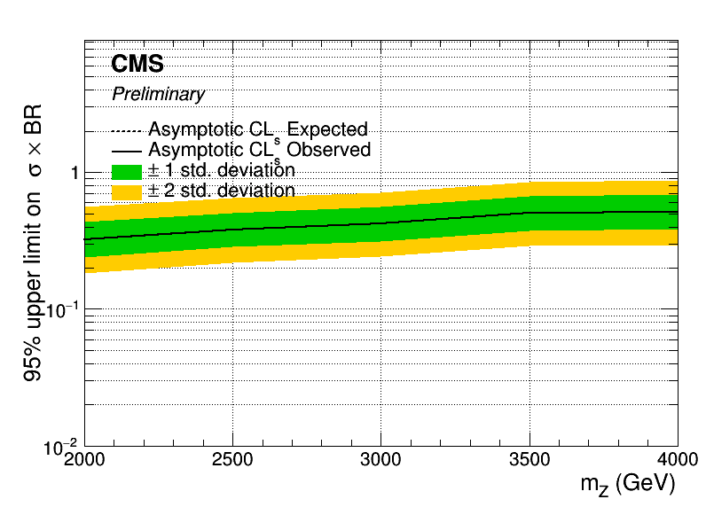
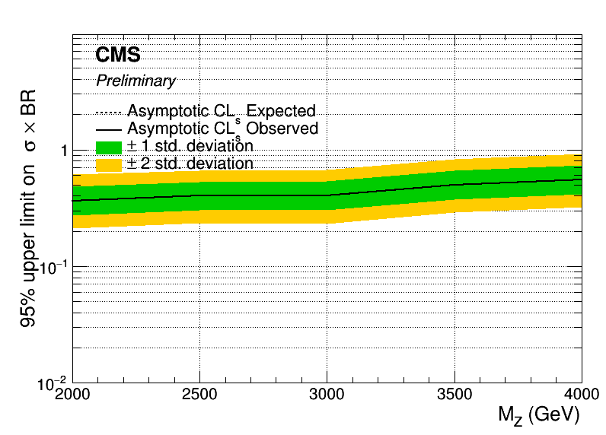
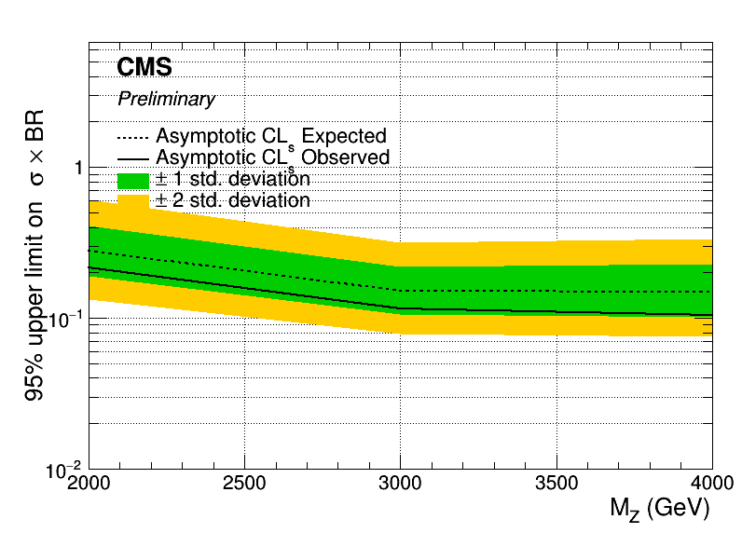
Asymptotic Limits width 30%
2017
2018
B2G-16-015

Slide 9
BACKUP

Slide 10
Signal Selection
Control Region Selection
Variables | Selected Cut
pT (both leading jets) | > 400 GeV
Njets | > 1
N leptons | = 0
|eta| (both leading jets) | < 2.4
mJJ | > 1000 GeV
jetMassSoftDrop (only for fit) | (50,300) GeV
Top Tagger | > 0.2, 0, 0.1
B tagging (2 btagged jets) | > Medium WP
Signal Trigger
Variables | Selected Cut
pT (both leading jets) | > 400 GeV
Njets | > 1
N leptons | = 0
|eta| (both leading jets) | < 2.4
mJJ | > 1000 GeV
jetMassSoftDrop (only for fit) | (50,300) GeV
Top Tagger | > 0.2, 0, 0.1
B tagging (0 btagged jets) | < Medium WP
Control Trigger

Slide 11
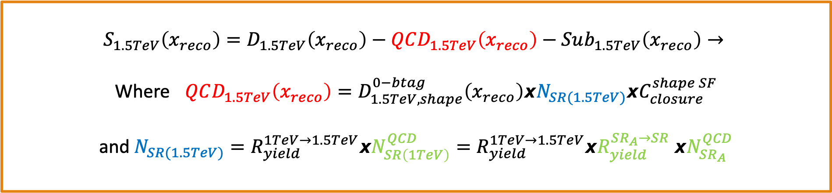
Signal Extraction
$$S_{1.5TeV}\left(x_{reco}\right)=D_{1.5TeV}\left(x_{reco}\right)−QCD_{1.5TeV}\left(x_{reco}\right)−Sub_{1.5TeV}\left(x_{reco}\right)→$$
Where $QCD_{1.5TeV}\left(x_{reco}\right)=D_{1.5TeV, shape}^{0−btag}\left(x_{reco}\right)xN_{SR(1.5TeV)}{xC}_{closure}^{shape SF}$
and $N_{SR(1.5TeV)}=R_{yield}^{1TeV→1.5TeV}xN_{SR\left(1TeV\right)}^{QCD}=R_{yield}^{1TeV→1.5TeV}xR_{yield}^{SR_{A}→SR} {xN}_{SR_{A}}^{QCD}$
The variable of interest here: x_{reco} → χ
1.5 TeV refers to the mJJ cut
We deploy a fit in the Signal Region (2btag) to extract the $N_{QCD}^{fit}$ in SRA (mJJ > 1TeV)
$$D{\left(m^{t}\right)}^{(i)}=N_{tt}^{(i)}T^{(i)}\left(m^{t},k_{MassScale}, k_{MassResolution}\right)+N_{bkg}^{(i)}B\left(m^{t} \right)\left(1+k_{1}x\right)+N_{sub}^{(i)}O^{(i)}\left(m^{t}\right)$$

Slide 12
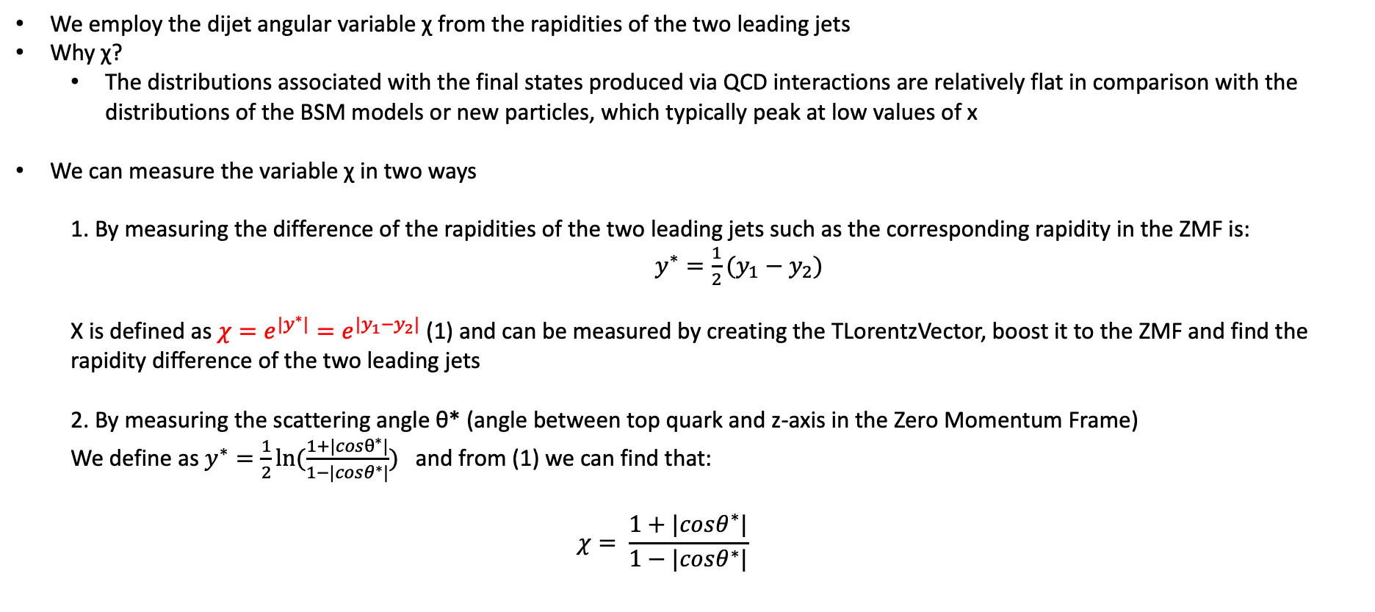
Top Angular Distributions
We employ the dijet angular variable χ from the rapidities of the two leading jets
Why χ?
The distributions associated with the final states produced via QCD interactions are relatively flat in comparison with the distributions of the BSM models or new particles, which typically peak at low values of x
We can measure the variable χ in two ways
1. By measuring the difference of the rapidities of the two leading jets such as the corresponding rapidity in the ZMF is: $y^{∗}=\frac{1}{2}(y_{1}−y_{2})$
Χ is defined as $χ=e^{{|y}^{∗}|}=e^{|y_{1}−y_{2}|}$ (1) and can be measured by creating the TLorentzVector, boost it to the ZMF and find the rapidity difference of the two leading jets
2. By measuring the scattering angle θ* (angle between top quark and z-axis in the Zero Momentum Frame)
We define as $y^{∗}=\frac{1}{2}ln⁡(\frac{1+|cosθ^{∗}|}{1−|cosθ^{∗}|})$ and from (1) we can find that:
$$χ= \frac{1+|cosθ^{∗}|}{1−|cosθ^{∗}|}$$

